Slide 1

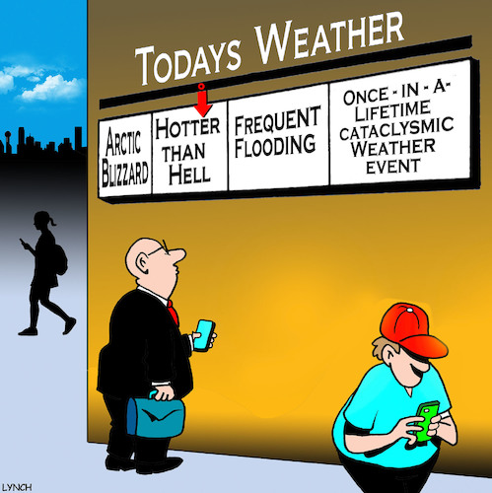



Weather and climate methods
Goal
Solutions
Conclusion
Copyright by Orfeo and Jason

